Slide 1

Design Pattern

Slide 2

Agenda
SOLID Principles
Builder,
Factories
Prototype
Singleton
Command
Interceptor
Observer
Interceptor,
Iterator,
Mediator,
Memento,
Observer,
Visitor,
Template Method,
Null Object,
State,
Stratergy
Chain Of Responsibility,Facade,Flyweight,Proxy,Adapter,Bridge,Composite,Decorator
2

Slide 3
SOLID Principle
S - SRP- Single Responsibility Principle
O - OP – Open Closed Principal
L - LSP – Liskov Substitution Principle
I - ISP – Interface Segregation Principle
D - DIP – Dependency Inversion Principle

Slide 4
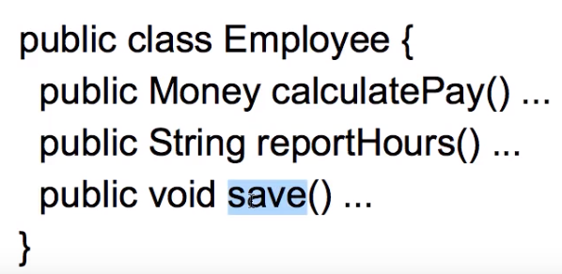
Single Responsibility Principle
A class should have one and only one reason to change.
Increase the possibility of reusability

Slide 5
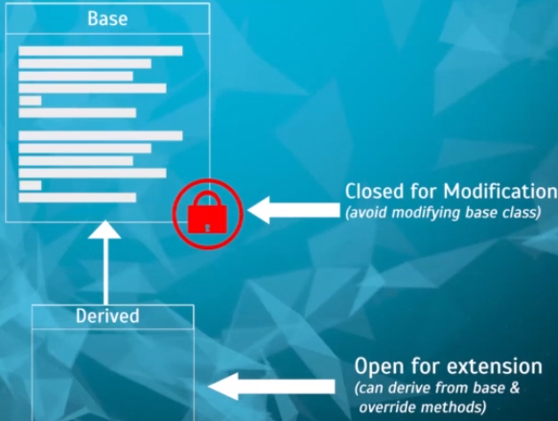
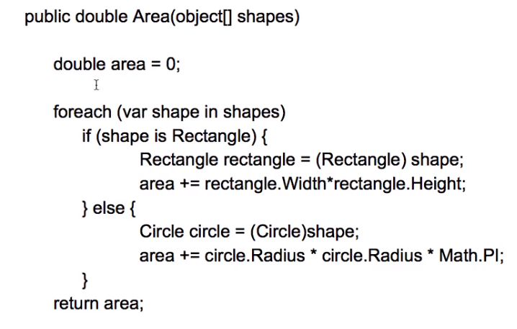
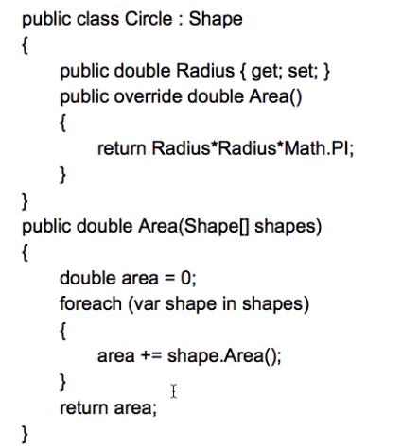
Open Closed Principle
Software entities should be open for extension but closed for modification.
Problem
Solution
To add a new shape, will lead to modification
Now, area is calculation is based on shape

Slide 6
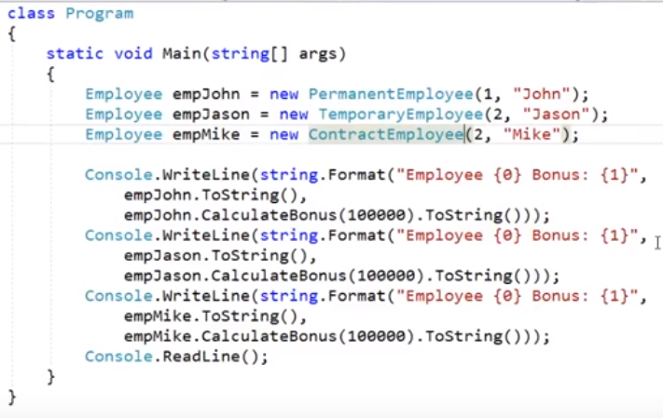
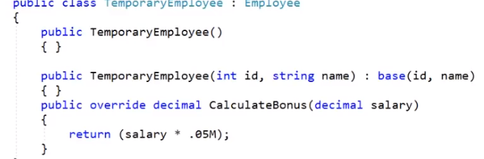
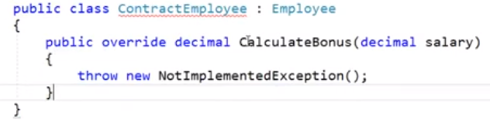
Liskov Substitution Principle
Substitute must be substitutable for their base types.
We should be to substitute the base class objects with child class objects
-> Barabara Liskov
Extension of Open closed principle.
No, new exception should be thrown by sub type

Slide 7
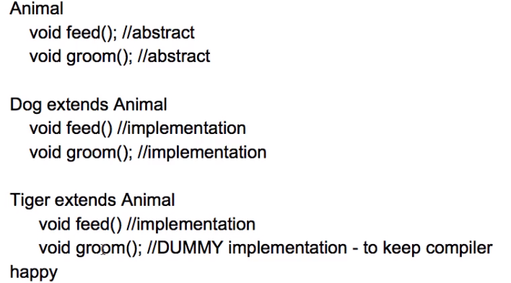
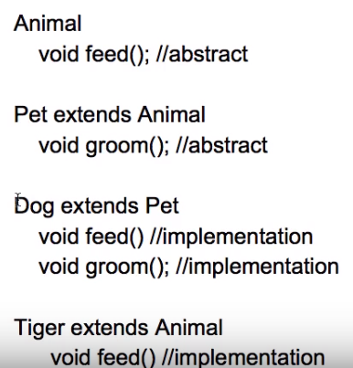
Interface Segregation Principle (ISP)
The dependency of one class to another one should depend on smallest possible interface.
Client should not force to implement interfaces they don’t use.
Problem
Solution

Slide 8
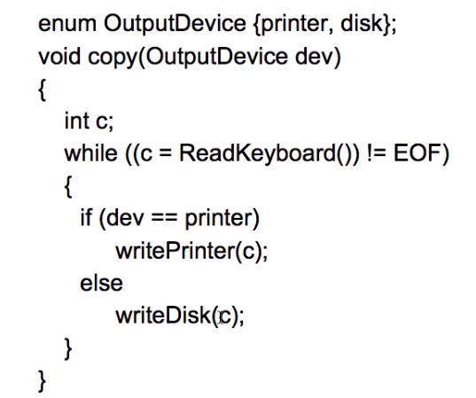
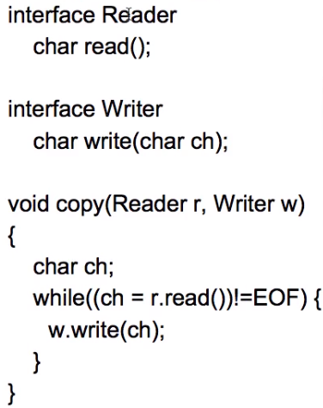
Dependency Inversion Principle
Dependent on interface not on concrete interfaces.
Introduced by “Robert C Martin”
Problem
Solution
On adding new IO device copy () must be updated.
Now no need to modify the copy()

Slide 9

What is Design Pattern

Slide 10
Design Pattern
Typical solutions to commonly occurring problems in software design. They are like pre-made blueprints that you can customize to solve a recurring design problem in your code.
The pattern is not a specific piece of code, but a general concept for solving a particular problem.
Advantages:
Reusable in multiple projects
Provide solutions for an effective system architecture
Provide clarity and transparency to the application design
Provide robust and highly maintainable code for easy understanding and debug
10

Slide 11
Classification of Design Pattern
Creational patterns provide object creation mechanisms that increase flexibility and reuse of existing code.
Structural patterns explain how to assemble objects and classes into larger structures, while keeping the structures flexible and efficient.
Behavioral patterns take care of effective communication and the assignment of responsibilities between objects.

Slide 12

Creational Design Pattern
12

Slide 13
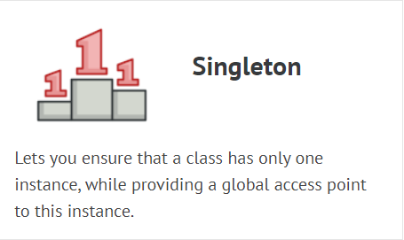
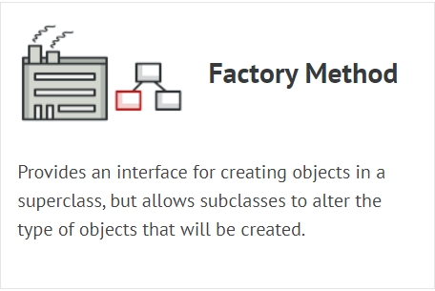
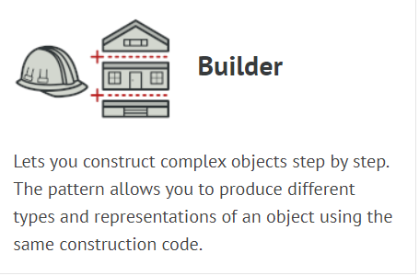
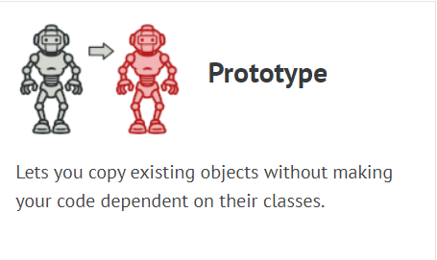
Creational Design Pattern
Provide various object creation mechanisms, which increase flexibility and reuse of existing code.

Slide 14
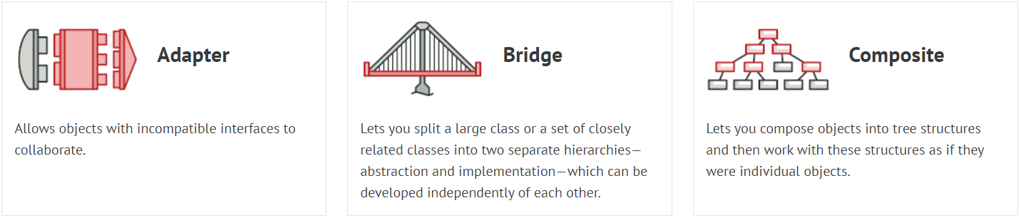
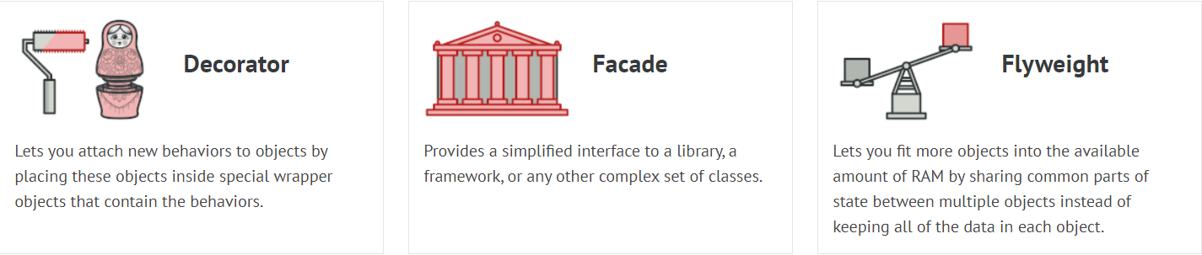
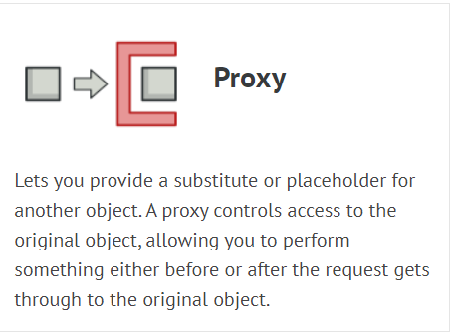
Structural Design Pattern
Structural patterns explain how to assemble objects and classes into larger structures while keeping these structures flexible and efficient.

Slide 15
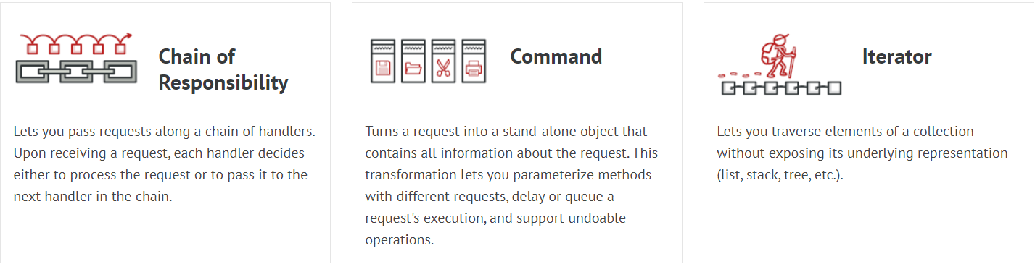
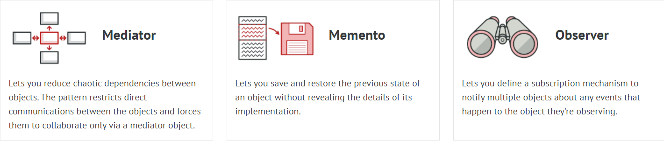
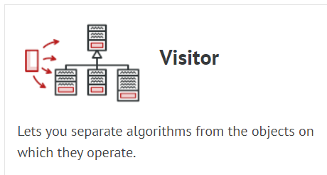
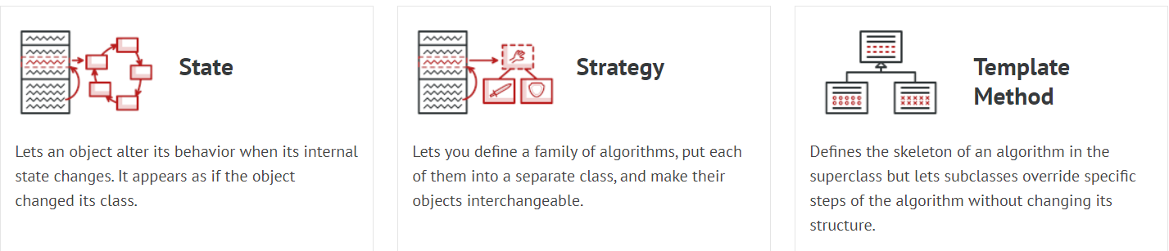
Behavioural Design Pattern
Behavioural design patterns are concerned with algorithms and the assignment of responsibilities between objects.

Slide 16
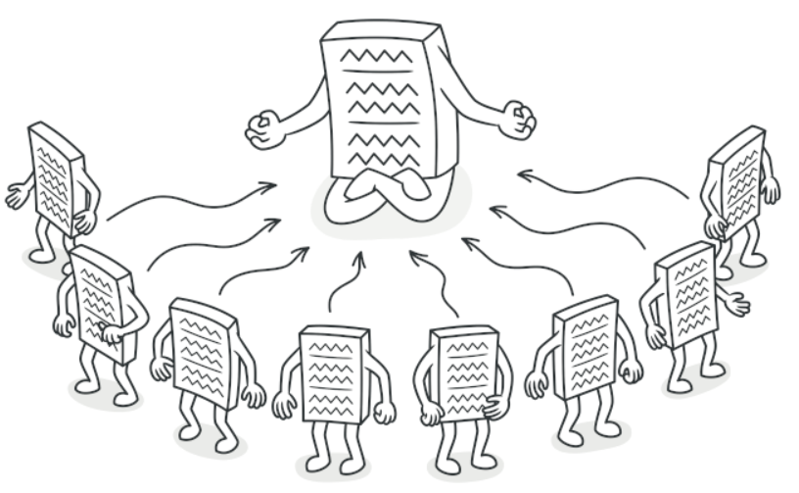
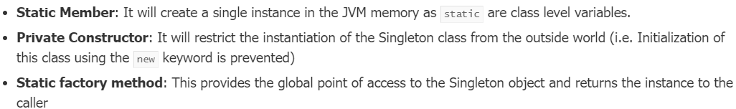
Creational – Singleton Design Pattern
Singleton is a creational design pattern that lets you ensure that a class has only one instance, while providing a global access point to this instance.
Real Time Example
Logger classes
Design the application that needs to work with the serial port.
To Implement SDP:-
Lazy Initialization – which means that it restricts the instance creation until it is requested for the first time.

Slide 17
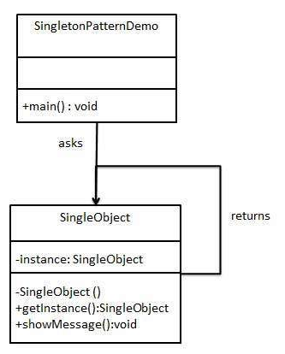
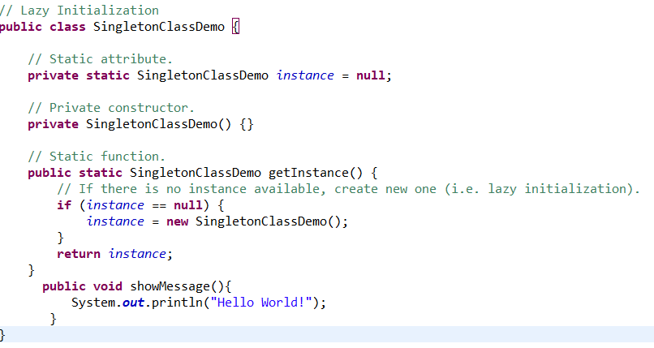
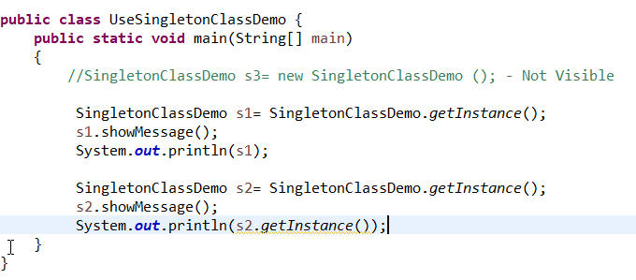
Creational – Singleton Design Pattern
Singleton is a creational design pattern that lets you ensure that a class has only one instance, while providing a global access point to this instance.

Slide 18
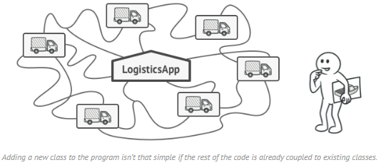
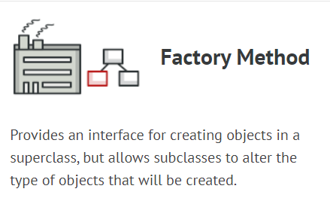
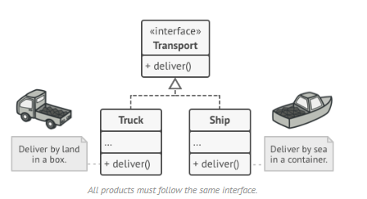
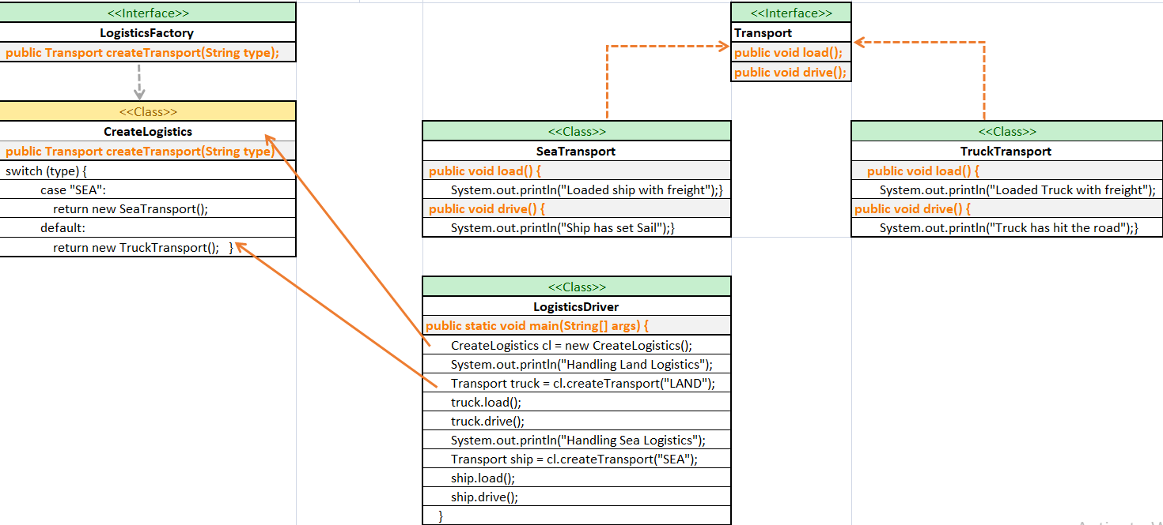
Creational – Factory Design Pattern
Problem – Logistics management application.
Your app can only handle transportation by trucks, so the bulk of your code lives inside the Truck class.
Later receive dozens of requests from sea transportation companies to incorporate sea logistics into the app.
Solution – Adding ship class -> Add Air class -> Nasty code and complexity
In Factory pattern, we create object without exposing the creation logic to the client and refer to newly created object using a common interface.
https://examples.javacodegeeks.com/factory-pattern-java-example/

Slide 19
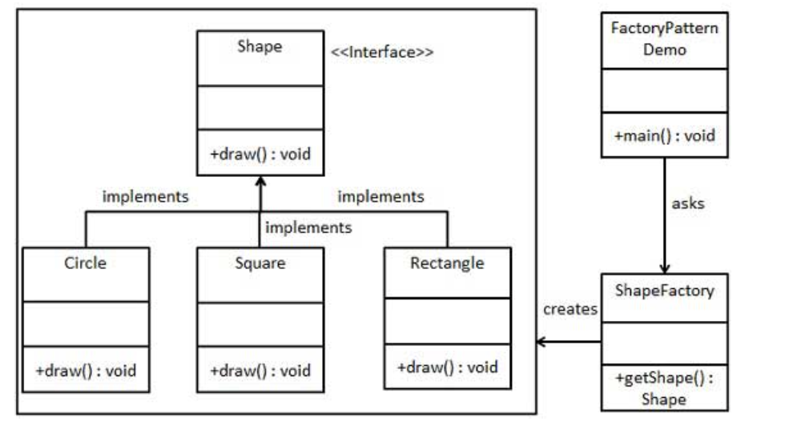
Factory Design Pattern

Slide 20
Creational – Factory Design Pattern
Applications
Use the Factory Method when you don’t know beforehand the exact types and dependencies of the objects your code should work with.
Use the Factory Method when you want to save system resources by reusing existing objects instead of rebuilding them each time.
Pros | Cons
You avoid tight coupling between the creator and the concrete products. | The code may become more complicated since you need to introduce a lot of new subclasses to implement the pattern. The best case scenario is when you’re introducing the pattern into an existing hierarchy of creator classes.
Single Responsibility Principle. You can move the product creation code into one place in the program, making the code easier to support.
Open/Closed Principle. You can introduce new types of products into the program without breaking existing client code.
https://examples.javacodegeeks.com/factory-pattern-java-example/

Slide 21
Creational – Builder Design Pattern
Lets you construct complex objects step by step.
The pattern allows you to produce different types and representations of an object using the same construction code.
Need:
Each of the different steps in the construction process can be declared as methods of a common interface to be implemented by different concrete builders.
A client object can create an instance of a concrete builder (SedanCarBuilder) and invoke the set of methods required to construct different parts of the final object. This approach requires every client object to be aware of the construction logic (specification of Sedan) . Whenever the construction logic undergoes a change, all client objects need to be modified accordingly.
The Builder pattern introduces another level of separation that addresses this problem. Instead of having client objects invoke different builder methods directly, the Builder pattern suggests using a dedicated object referred to as a Director, which is responsible for invoking different builder methods required for the construction of the final object. Different client objects can make use of the Director object to create the required object. Once the object is constructed, the client object can directly request from the builder the fully constructed object. To facilitate this process, a new method getObject can be declared in the common Builder interface to be implemented by different concrete builders.

Slide 22
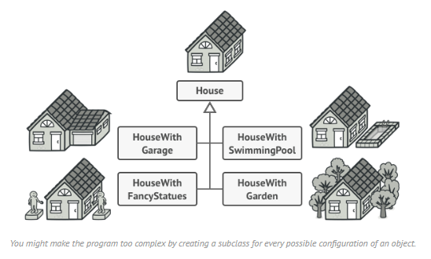
Creational – Builder Design Pattern
Problem:
Imagine a complex object that requires laborious, step-by-step initialization of many fields and nested objects. Such initialization code is usually buried inside a monstrous constructor with lots of parameters. Or even worse: scattered all over the client code.
For example: let’s think about how to create a House object. To build a simple house, you need to construct four walls and a floor, install a door, fit a pair of windows, and build a roof. But what if you want a bigger, brighter house, with a backyard and other goodies (like a heating system, plumbing, and electrical wiring)?
The simplest solution is to extend the base House class and create a set of subclasses to cover all combinations of the parameters. But eventually you’ll end up with a considerable number of subclasses. Any new parameter, such as the porch style, will require growing this hierarchy even more.
There’s another approach that doesn’t involve breeding subclasses. You can create a giant constructor right in the base House class with all possible parameters that control the house object. While this approach indeed eliminates the need for subclasses, it creates another problem.

Slide 23
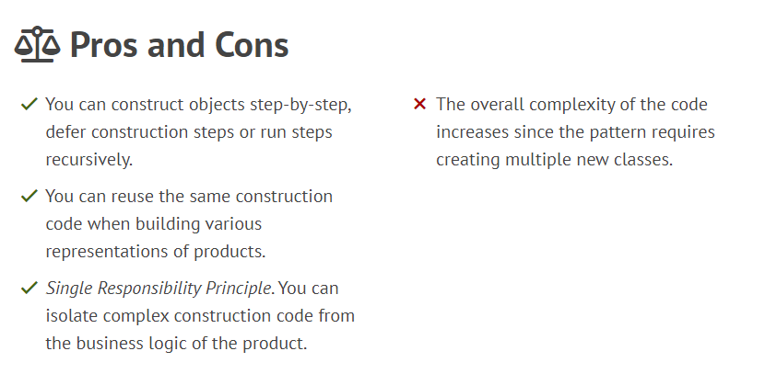
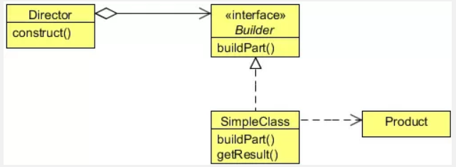
Creational – Builder Design Pattern
Builder (CarBuilder)
Specifies an abstract interface for creating parts of a Product object.
ConcreteBuilder (SedanBuilder, SportsCarBuilder)
Constructs and assembles parts of the product by implementing the Builder interface.
Defines and keeps track of the representation it creates.
Provides an interface for retrieving the product.
Director (CarDirector)
Constructs an object using the Builder interface.
Product
Represents the complex object under construction. ConcreteBuilder builds the product’s internal representation and defines the process by which it’s assembled.
Includes classes that define the constituent parts, including interfaces for assembling the parts into the final result.

Slide 24
Structural Design Pattern
Object Relational Mapping
24

Slide 25
Prototype Design Pattern
Prototype is a creational design pattern that lets you copy existing objects without making your code dependent on their classes.
Prototype allows us to hide the complexity of making new instances from the client. The concept is to copy an existing object rather than creating a new instance from scratch, something that may include costly operations.
The existing object acts as a prototype and contains the state of the object. The newly copied object may change same properties only if required. This approach saves costly resources and time, especially when object creation is a heavy process.

Slide 26
Advantages
Adding and removing products at run-time – Prototypes let you incorporate a new concrete product class into a system simply by registering a prototypical instance with the client. That’s a bit more flexible than other creational patterns, because a client can install and remove prototypes at run-time.
Specifying new objects by varying values – Highly dynamic systems let you define new behavior through object composition by specifying values for an object’s variables and not by defining new classes.
Specifying new objects by varying structure – Many applications build objects from parts and subparts. For convenience, such applications often let you instantiate complex, user-defined structures to use a specific subcircuit again and again.
Reduced subclassing – Factory Method often produces a hierarchy of Creator classes that parallels the product class hierarchy. The Prototype pattern lets you clone a prototype instead of asking a factory method to make a new object. Hence you don’t need a Creator class hierarchy at all.

Slide 27
Disadvantages
Overkill for a project that uses very few objects and/or does not have an underlying emphasis on the extension of prototype chains.
It also hides concrete product classes from the client.
Each subclass of Prototype must implement the clone() operation which may be difficult, when the classes under consideration already exist. Also implementing clone() can be difficult when their internals include objects that don’t support copying or have circular references.

Slide 28
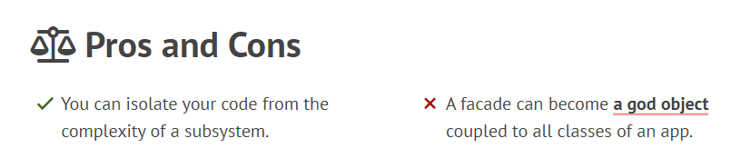
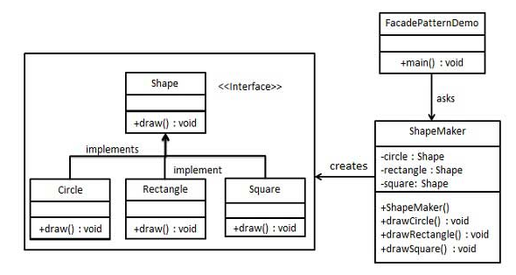
Structural – Facade
Facade is a structural design pattern that provides a simplified interface to a library, a framework, or any other complex set of classes. Facade pattern hides the complexities of the system and provides an interface to the client using which the client can access the system. This type of design pattern comes under structural pattern as this pattern adds an interface to existing system to hide its complexities.
This pattern involves a single class which provides simplified methods required by client and delegates calls to methods of existing system classes.
Eg: For instance, an app that uploads short funny videos with cats to social media could potentially use a professional video conversion library. However, all that it really needs is a class with the single method encode(filename, format). After creating such a class and connecting it with the video conversion library, you’ll have your first facade.

Slide 29
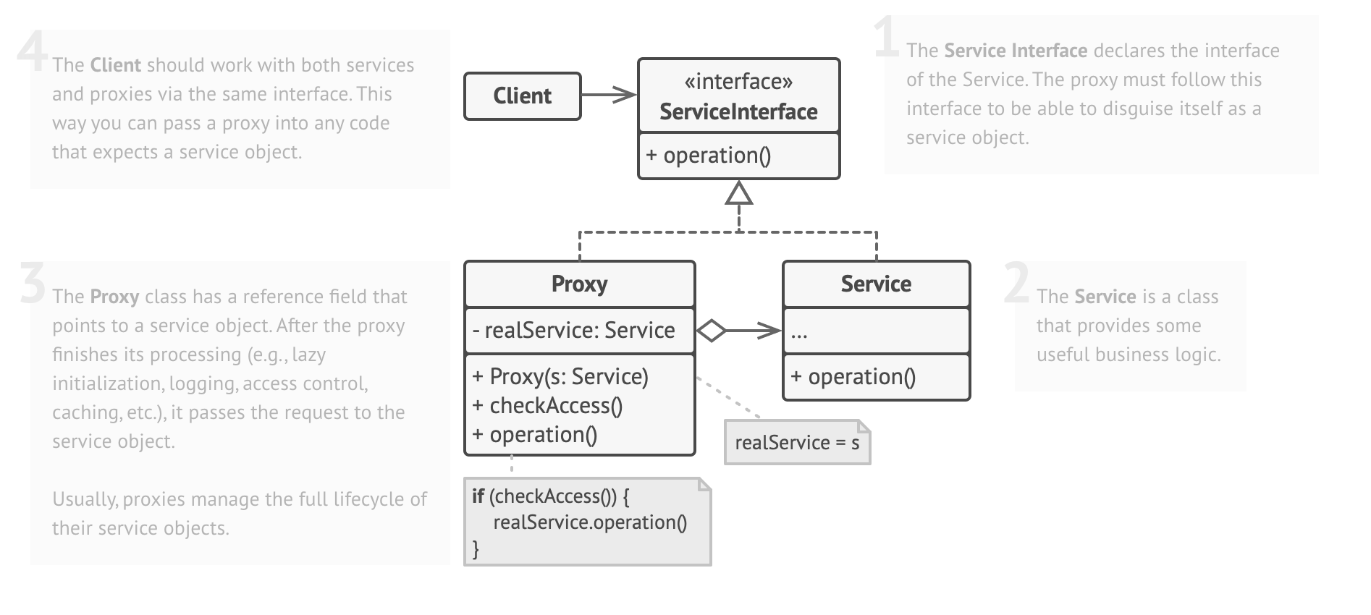
Proxy Design Pattern
Proxy is a structural design pattern that lets you provide a substitute or placeholder for another object.
Real World Example:
A credit card is a proxy for a bank account, which is a proxy for a bundle of cash.
Both implement the same interface: they can be used for making a payment.
A consumer feels great because there’s no need to carry loads of cash around.
A shop owner is also happy since the income from a transaction gets added electronically to the shop’s bank account without the risk of losing the deposit or getting robbed on the way to the bank.

Slide 30
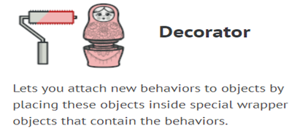
Structural – Decorator Design Pattern
The intent of the Decorator Design Pattern is to attach additional responsibilities to an object dynamically.
Decorators provide a flexible alternative to sub-classing for extending functionality.
Extending a class is the first thing that comes to mind when you need to alter an object’s behaviour. However, inheritance has several serious caveats that you need to be aware of.
Inheritance is static. You can’t alter the behavior of an existing object at runtime. You can only replace the whole object with another one that’s created from a different subclass.
Subclasses can have just one parent class. In most languages, inheritance doesn’t let a class inherit behaviours of multiple classes at the same time.
Wrapper is the alternative nickname for the Decorator pattern that clearly expresses the main idea of the pattern.
A “wrapper” is an object that can be linked with some “target” object.
The wrapper contains the same set of methods as the target and delegates to it all requests it receives.
However, the wrapper may alter the result by doing something either before or after it passes the request to the target.

Slide 31
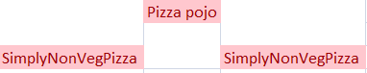
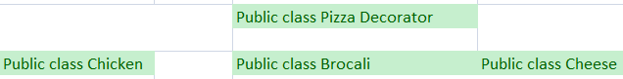
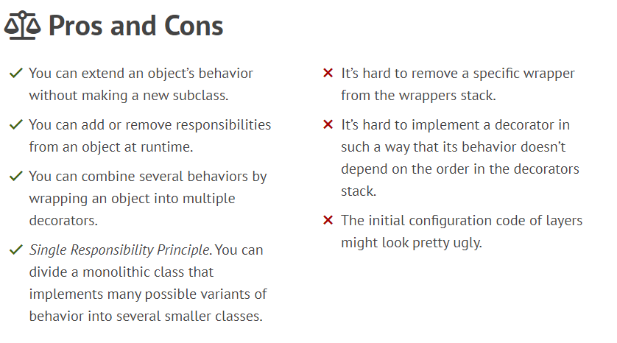
Structural – Decorator Design Pattern

Slide 32
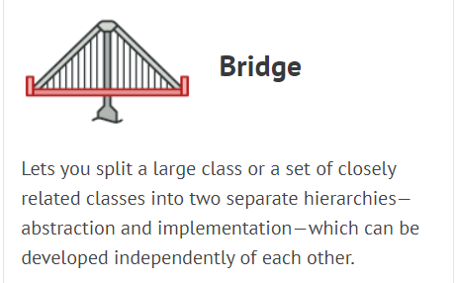
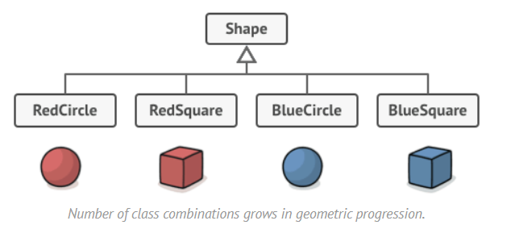
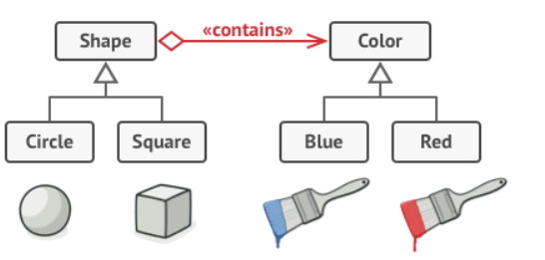
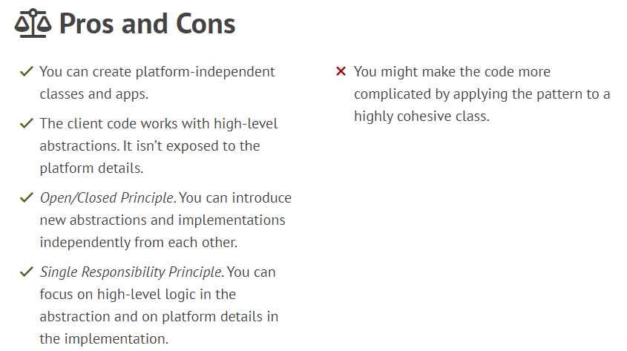
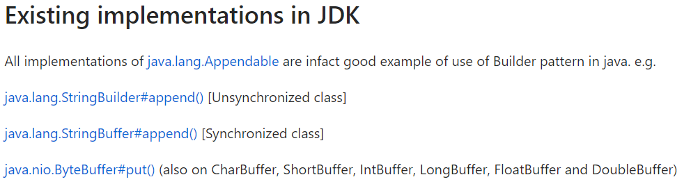
Structural – Bridge Design Pattern
Problem
Bridge
The Bridge pattern attempts to solve this problem by switching from inheritance to the object composition.

Slide 33
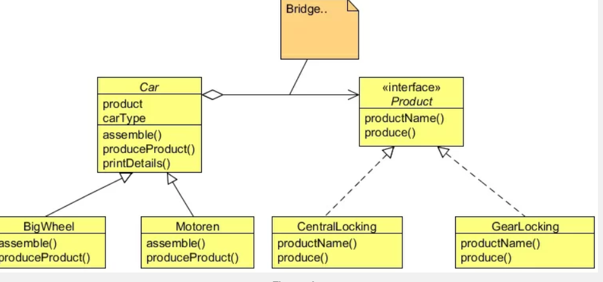
Structural – Bridge Design Pattern
The Bridge Pattern’s intent is to decouple an abstraction from its implementation so that the two can vary independently.
The Bridge Pattern decouples the interface and the implementation. As a result, an implementation is not bound permanently to an interface. The implementation of an abstraction can be configured at run-time.
It also eliminates compile-time dependencies on the implementation. Changing an implementation class doesn’t required recompiling the abstraction class and its clients.
The Client only needs to know about the abstraction and you can hide the implementation from them.

Slide 34
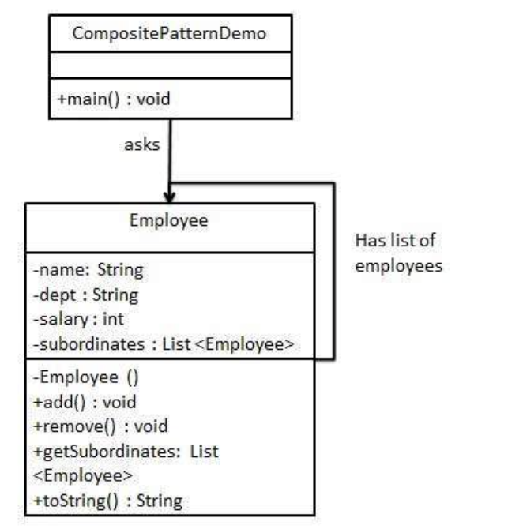
Command Design Pattern
Composite pattern is used where we need to treat a group of objects in similar way as a single object.
Composite pattern composes objects in term of a tree structure to represent part as well as whole hierarchy.
This type of design pattern comes under structural pattern as this pattern creates a tree structure of group of objects.
This pattern creates a class that contains group of its own objects. This class provides ways to modify its group of same objects.

Slide 35
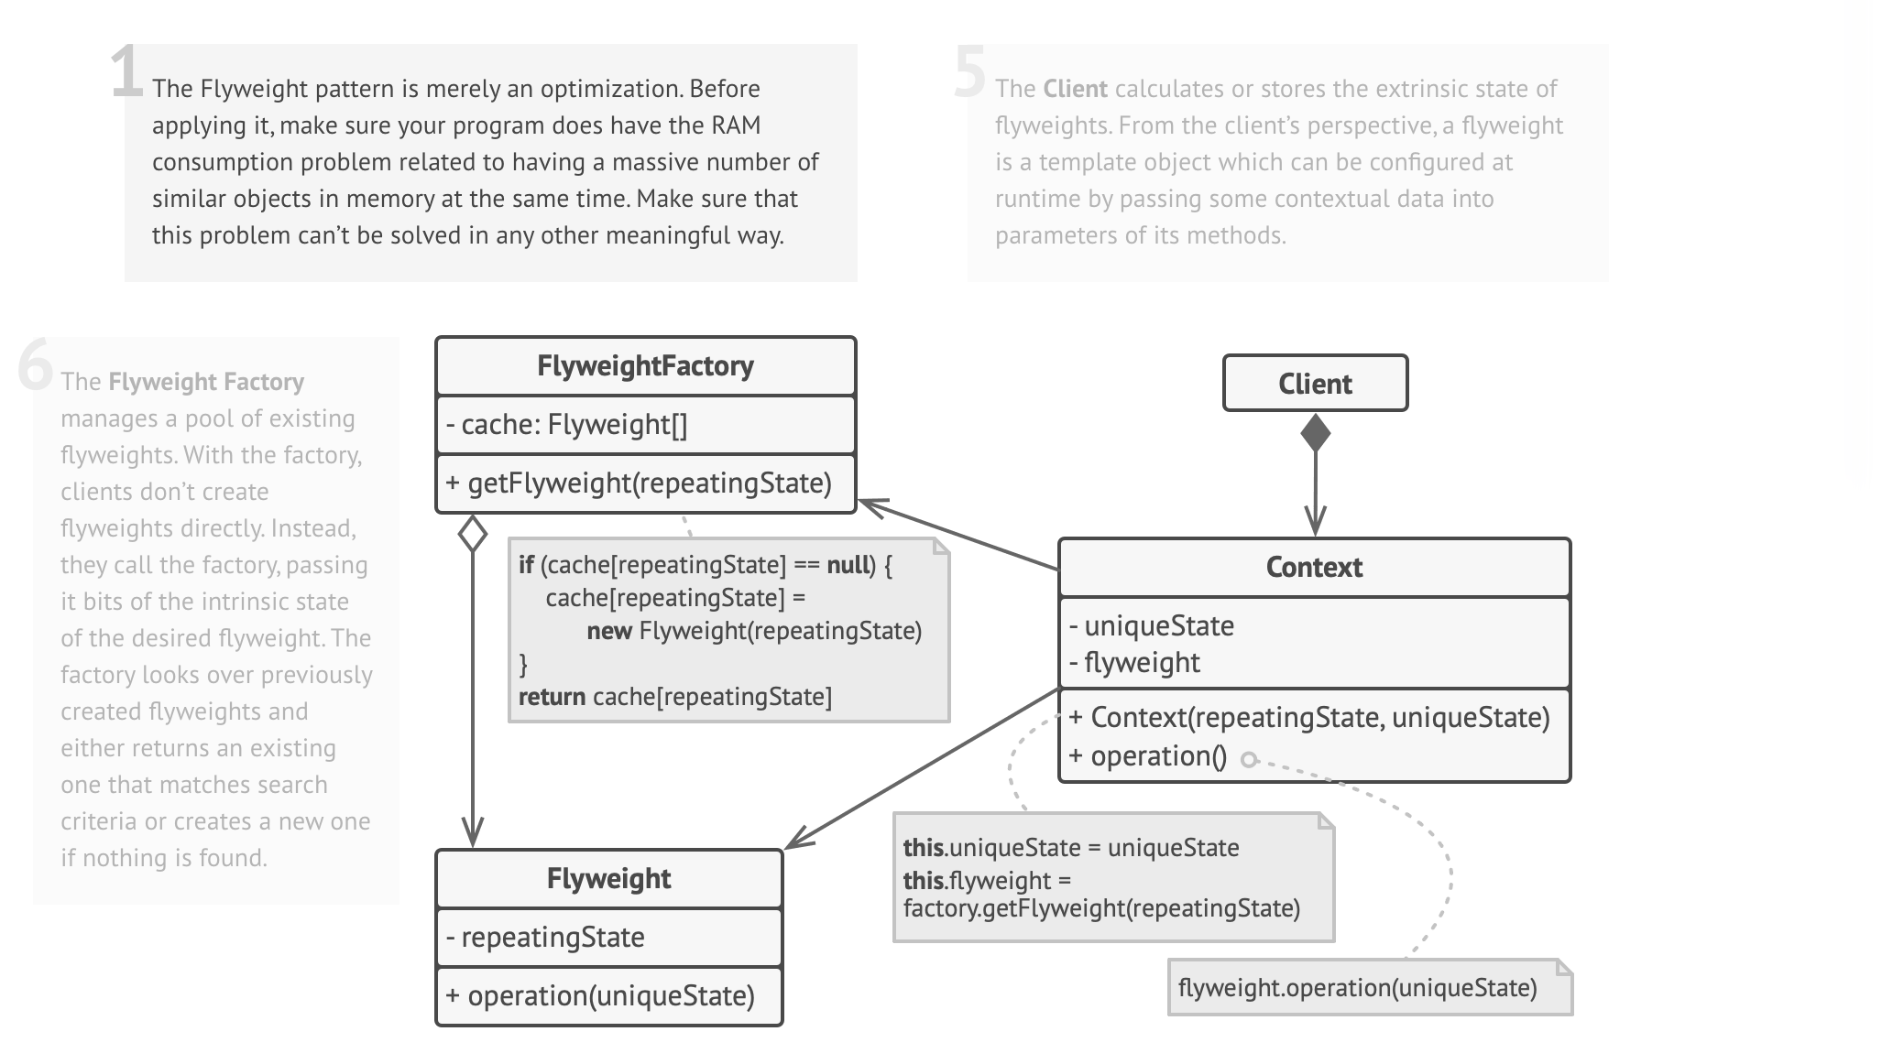
Flyweight
Flyweight pattern is primarily used to reduce the number of objects created and to decrease memory footprint and increase performance.
Flyweight pattern tries to reuse already existing similar kind objects by storing them and creates new object when no matching object is found.
Flyweight is a structural design pattern that lets you fit more objects into the available amount of RAM by sharing common parts of state between multiple objects instead of keeping all of the data in each object

Slide 36
Behavioral Design Pattern
36

Slide 37

Behavioural – Chain of Responsibility
Chain of Responsibility is a behavioural design pattern that lets you pass requests along a chain of handlers. Upon receiving a request, each handler decides either to process the request or to pass it to the next handler in the chain.
When to use?
1. More than one objects may handle a request.
2. You want to issue a request to one of several objects without specifying the receiver explicitly.
3. The set of objects that can handle a request should be specified dynamically.

Slide 38



Behavioural – Mediator
Mediator is a behavioural design pattern that lets you reduce chaotic dependencies between objects. The pattern restricts direct communications between the objects and forces them to collaborate only via a mediator object.
The Mediator Pattern defines an object that encapsulates how a set of objects interact.

Slide 39
Observer Pattern
Publisher Subscriber Object Model
Whenever one to many dependency between objects where many objects are listening for state change of a single object, without tightly coupling all of them together.
It is often implemented where listener only gets notification that “Something “ has changes in object’s state. Listener query back to find out more information if needed . This makes it more generic as different listeners may be interested in different states.
An observer pattern (also called a publisher subscriber pattern) consists of a subject and many observers. The subject notifies the observer in case of a change in state.
Example 1: Subject - Recruiter
Observer –Job Hunter
The Subject (the notification service) should be able to Add an observer
Remove an Observer
Notify an Observer
Example 2: Suppose you want to write an application where any time a particular SQL server goes down, you want certain groups to be notified. The diagram below shows at a high level what we are trying to achieve.

Slide 40

Observer Design Pattern

Slide 41

Behavioural – Mediator
The classess which hold reference of the mediator are called colleagues. The major participants of the Mediator Pattern:
Mediator: Defines an interface for communicating with Colleague objects.
ConcreteMediator: Implements cooperative behavior by coordinating Colleague objects. It also knows and maintains its colleagues.
Colleague Classes: Each Colleague class knows its Mediator object. Each colleague communicates with its mediator whenever it would have otherwise communicated with another colleague.
Steps:
Create mediator class - ChatRoom.java
Create user class - User.java
Use the User object to show communications between them. - MediatorPatternDemo

Slide 42


Behavioural Design Pattern - State
Allows an object to alter its behaviour when its internal state changes.
When to use?
An object which can be in different states during it’s life-cycle and how it processes incoming requests (or make state transitions) based
on it’s present state – we can use the state pattern.

Slide 43
Behavioural- Strategy Design Pattern
Strategy pattern enables a client code to choose from a family of related but different algorithms and gives it a simple way to choose any of the algorithm in runtime depending on the client context.
ISocialMediaStrategy – The interface which abstract the operation.
SocialMediaContext – The context which determines the implementation.
Implementations – Various implementations of ISocialMediaStrategy. E.g. FacebookStrategy, GooglePlusStrategy, TwitterStrategy

Slide 44
Behavioural Design Pattern - iterator
Intent –
The intent of the Iterator Design Pattern is to provide a way to access the elements of an aggregate object sequentially without exposing its underlying representation.
The Iterator pattern allows a client object to access the contents of a container in a sequential manner, without having any knowledge about the internal representation of its contents.
The term container, used above, can simply be defined as a collection of data or objects.
The objects within the container could in turn be collections, making it a collection of collections.

Slide 45
Behavioral Design Pattern : Interceptor
Interpreter pattern provides a way to evaluate language grammar or expression. This type of pattern comes under behavioral pattern.
This pattern involves implementing an expression interface which tells to interpret a particular context.
This pattern is used in SQL parsing, symbol processing engine etc.

Slide 46

Momento
Memento pattern is used to restore state of an object to a previous state. Memento pattern falls under behavioral pattern category.
Memento pattern uses three actor classes.
Memento contains state of an object to be restored.
Originator creates and stores states in Memento objects .
Caretaker object is responsible to restore object state from Memento.

Slide 47

Visitor
Execution algorithm of element can vary as and when visitor varies.
This pattern comes under behavior pattern category.
As per the pattern, element object has to accept the visitor object so that visitor object handles the operation on the element object.

Slide 48

Template Design Pattern
Template method design pattern is to define an algorithm as a skeleton of operations and leave the details to be implemented by the child classes.
The overall structure and sequence of the algorithm are preserved by the parent class.
Template means Preset format like HTML templates which has a fixed preset format. Similarly in the template method pattern, we have a preset structure method called template method which consists of steps. These steps can be an abstract method that will be implemented by its subclasses.

Slide 49
Null Object
In Null Object pattern, a null object replaces check of NULL object instance. Instead of putting if check for a null value, Null Object reflects a do nothing relationship.
Such Null object can also be used to provide default behaviour in case data is not available.

